Slide 1
Lecture 11 Principal Component Analysis
EE-uy 4563 / EL-Gy 9123: Introduction to machine learning
Prof. Sundeep rangan, With Modification by yao wang and Yuan Wang

Slide 2
Goal: find a “good ” representation
representation
(nuisances)
data
task
Sufficient (for the task): I(data; task) = I(representation; task)
Minimal (information): I(data; representation) is minimal
Invariant (to nuisances): I(nuisances; task) = 0

Slide 3


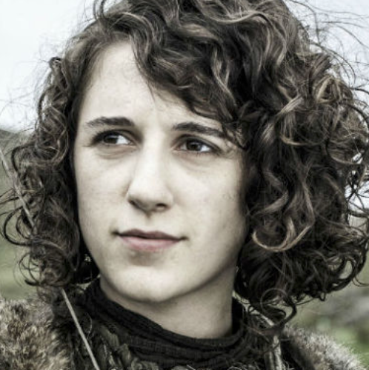
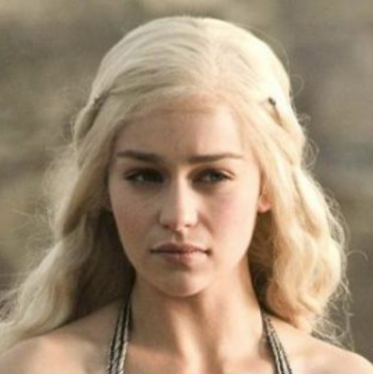

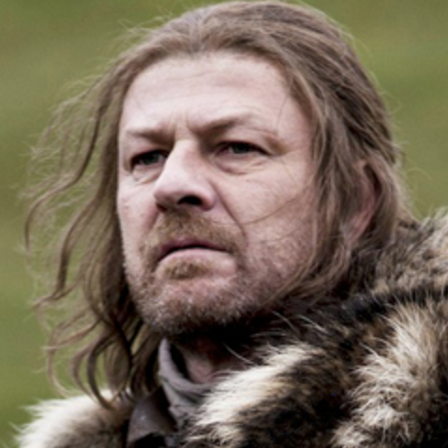
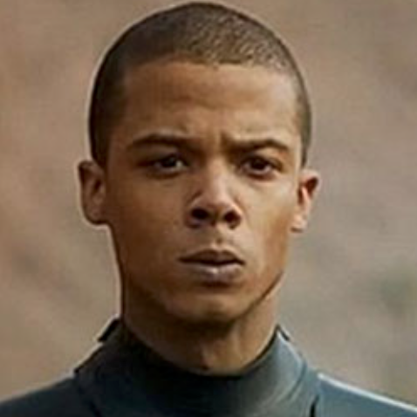
Goal: find a “good ” representation
Example task: identify Jon Snow in images.
Images from the Internet

Slide 4
Goal: find a “good ” representation
Example task: identify Jon Snow in images.
y
Sufficient
Minimal
Invariant
o
Linear classifier
x

Slide 5
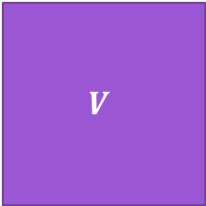


Goal: find a “good ” representation
Today we focus on the simplest linear case:
$$V$$
$$\tilde{x}$$
=
$$α$$
x
sample
coefficient
Dictionary / bases

Slide 6
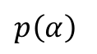
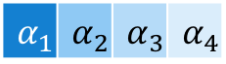
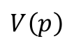
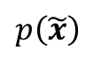
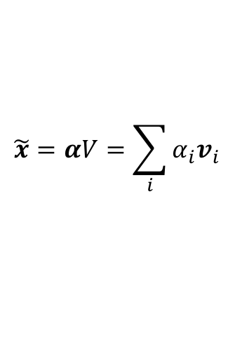
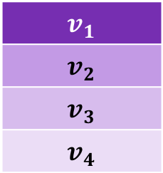
Goal: find a “good ” representation
Today we focus on the simplest linear case:
$$\tilde{x}=αV=\sum_{i}{α_{i}v_{i}}$$
$$v_{1}$$
$$v_{2}$$
$$v_{3}$$
$$v_{4}$$
$$\tilde{x}$$
=
$$α_{1}$$ | $$α_{2}$$ | $$α_{3}$$ | $$α_{4}$$
x
sample
coefficient
Dictionary / bases
$$p\left(\tilde{x}\right)$$
$$p\left(α\right)$$
$$V\left(p\right)$$

Slide 7

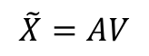

Goal: find a “good ” representation
Today we focus on the simplest linear case:
$$\tilde{X}$$
$$Α$$
$$V$$
$$\tilde{X}=AV$$
=
x
Data(many samples in rows)
coefficients
Dictionary / bases

Slide 8
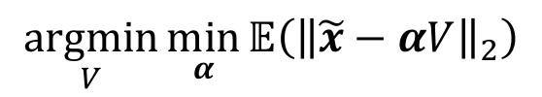

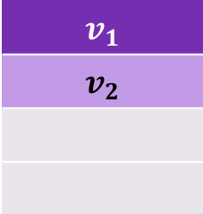
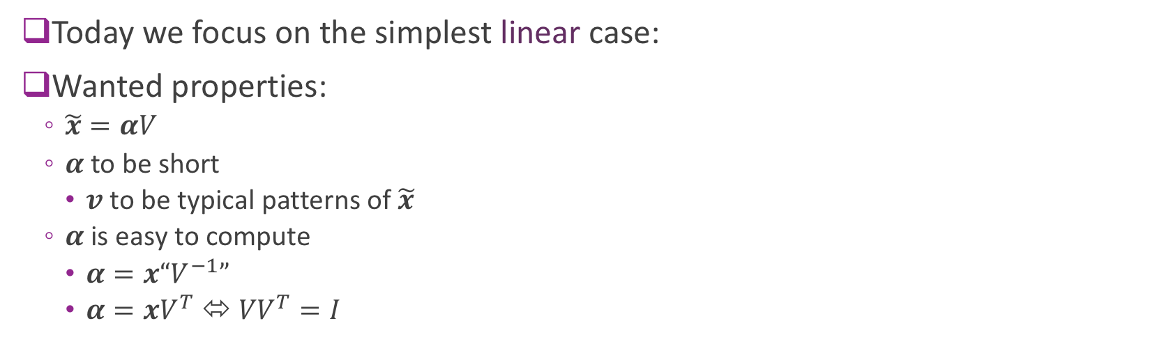

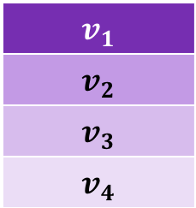
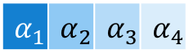
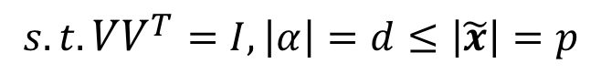
Goal: find a “good ” representation
Today we focus on the simplest linear case:
Wanted properties:
$\tilde{x}=αV$
$α$ to be short
$v$ to be typical patterns of $\tilde{x}$
$α$ is easy to compute
$α=x“V^{−1}”$
$α={xV}^{T}$ ⬄ ${VV}^{T}=I$
$$\underset{V}{argmin}{\min_{α}{𝔼\left({\left\|\tilde{x}−αV\right\|}_{2}\right)}}$$
$$s.t.{VV}^{T}=I, \left|α\right|=d≤\left|\tilde{x}\right|=p$$
$$v_{1}$$
$$v_{2}$$
$$v_{1}$$
$$v_{2}$$
$$v_{3}$$
$$v_{4}$$
=
$$α_{1}$$ | $$α_{2}$$
x
$$\tilde{x}$$
$$α_{1}$$ | $$α_{2}$$ | $$α_{3}$$ | $$α_{4}$$

Slide 9

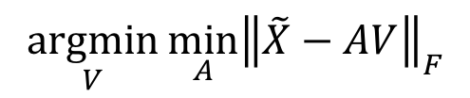



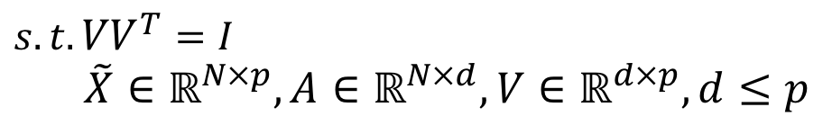

Goal: find a “good ” representation
Today we focus on the simplest linear case:
Wanted properties:
$\tilde{x}=αV$
$α$ to be short
$v$ to be typical patterns of $\tilde{x}$
$α$ is easy to compute
$α=x“V^{−1}”$
$α={xV}^{T}$ ⬄ ${VV}^{T}=I$
$$\underset{V}{argmin}{\min_{A}{{\left\|\tilde{X}−AV\right\|}_{F}}}$$
$s.t.{VV}^{T}=I$
$\tilde{X}∈ℝ^{N×p},A∈ℝ^{N×d},V∈ℝ^{d×p}, d≤p$
$$\tilde{X}$$
$$Α$$
$$Α$$
$$V$$
$$V$$
=
x

Slide 10
Outline
Dimensionality reduction
Principal components and directions of variance (a geometric perspective)
Computing PCs via the SVD
Approximation with PCs
Face example in python
Extensions

Slide 11
Dimensionality Reduction
Many modern data sets have very high dimension
Want to reduce dimension:
The Curse of Dimensionality (task “difficulty” ~ exp(d))
Visualize data
Find underlying commonalities in data

Slide 12
Outline
Dimensionality reduction
Principal components and directions of variance (a geometric perspective)
Computing PCs via the SVD
Approximation with PCs
Face example in python
Extensions

Slide 13
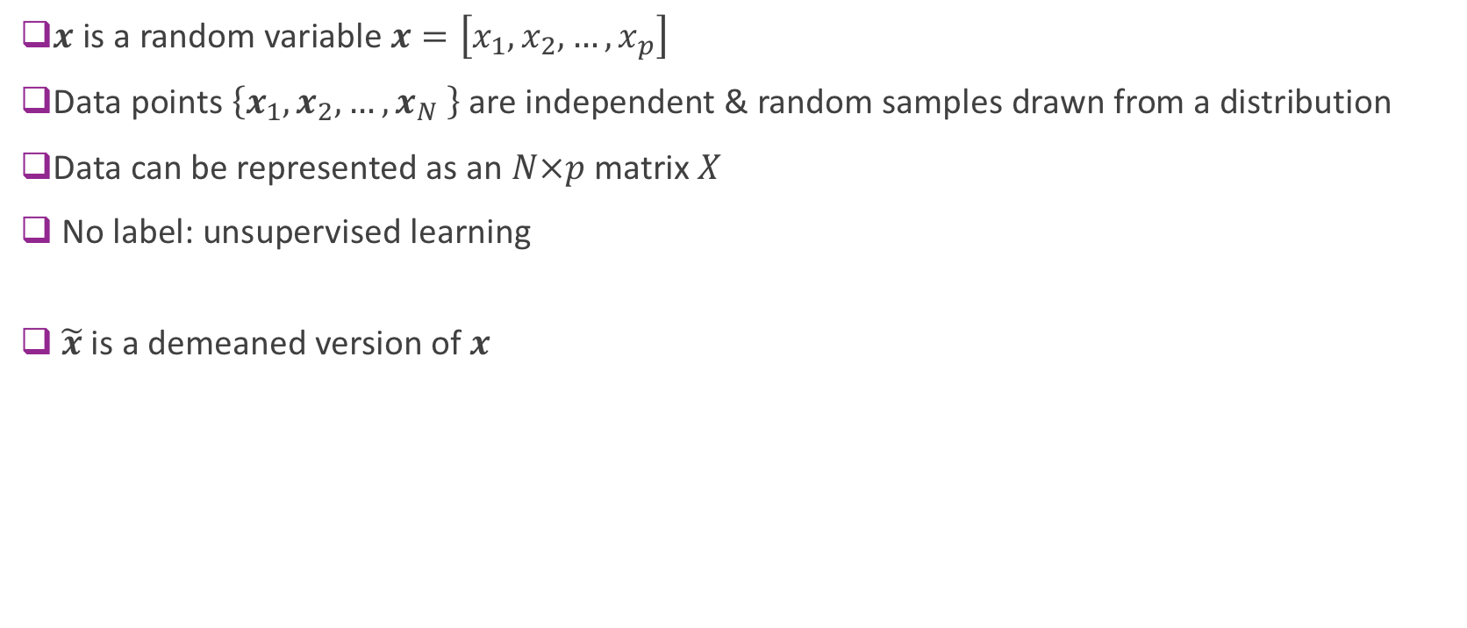
Data Definitions
$x$ is a random variable $x=\left[x_{1}, x_{2}, …, x_{p}\right]$
Data points $\left\{x_{1}, x_{2}, …, x_{N} \right\}$ are independent & random samples drawn from a distribution
Data can be represented as an $N×p$ matrix $X$
No label: unsupervised learning
$\tilde{x}$ is a demeaned version of $x$

Slide 14


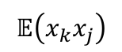
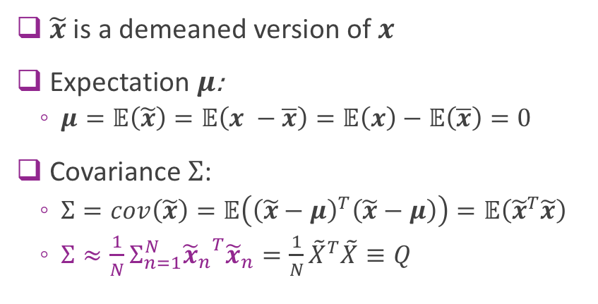




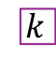
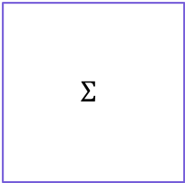
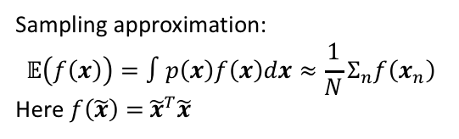
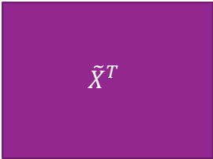

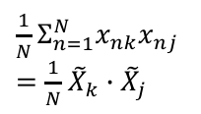


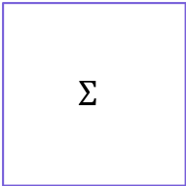
Simple properties of $\tilde{x}$
$\tilde{x}$ is a demeaned version of $x$
Expectation $μ$:
$μ=𝔼\left(\tilde{x}\right)=𝔼\left(x −\overline{x}\right)=𝔼\left(x\right)−𝔼\left(\overline{x}\right)=0$
Covariance $Σ$:
$Σ=cov\left(\tilde{x}\right)=𝔼\left({\left(\tilde{x}−μ\right)}^{T}\left(\tilde{x}−μ\right)\right)=𝔼\left({\tilde{x}}^{T}\tilde{x}\right)$
$Σ≈\frac{1}{N}Σ_{n=1}^{N}{{\tilde{x}}_{n}}^{T}{\tilde{x}}_{n}=\frac{1}{N}{\tilde{X}}^{T}\tilde{X}≡Q$
$$\tilde{x}$$
$$j$$
$$\tilde{X}$$
$$j$$
$$𝔼\left(x_{k}x_{j}\right)$$
$$Σ$$
$${\tilde{x}}^{T}$$
$$kj$$
$$k$$
Sample covariance
Simple manipulation
$\frac{1}{N}Σ_{n=1}^{N}x_{nk}x_{nj}$
$=\frac{1}{N}$ ${\tilde{X}}_{k}∙{\tilde{X}}_{j}$
$$Σ$$
$${\tilde{X}}^{T}$$
$$kj$$
$$k$$
Sampling approximation:
$$𝔼\left(f\left(x\right)\right)=∫p\left(x\right)f\left(x\right)dx≈\frac{1}{N}Σ_{n}f\left(x_{n}\right)$$
Here $f\left(\tilde{x}\right)=$ ${\tilde{x}}^{T}\tilde{x}$

Slide 15
Geometric intuition
y
How to find the new coordinate system?
How specify a axis?
2 points in the space in general
1 point with common start point
Data mean serves a good candidate
x'
y’
o’
o
x

Slide 16
Geometric intuition
y
Demean, so that the origin is 0.
What is the key property of the new axis?
x'
v
x
o

Slide 17
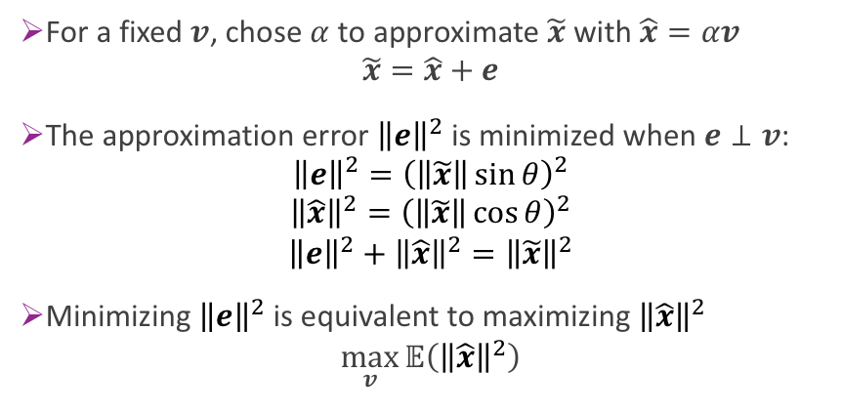
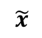
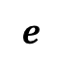
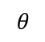
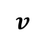
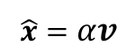
Geometric intuition
y
Demean, so that the origin is 0.
What is the key property of the new axis?
$$\tilde{x}$$
$$e$$
$$v$$
For a fixed $v$, chose $α$ to approximate $\tilde{x}$ with $\hat{x}=αv$
$$\tilde{x}=\hat{x}+e$$
The approximation error ${\left\|e\right\|}^{2}$ is minimized when $e⊥v$:
$${\left\|e\right\|}^{2}={\left(\left\|\tilde{x}\right\|\sin{θ}\right)}^{2}$$
$${\left\|\hat{x}\right\|}^{2}={\left(\left\|\tilde{x}\right\|\cos{θ}\right)}^{2}$$
$${\left\|e\right\|}^{2}+{\left\|\hat{x}\right\|}^{2}={\left\|\tilde{x}\right\|}^{2}$$
Minimizing ${\left\|e\right\|}^{2}$ is equivalent to maximizing ${\left\|\hat{x}\right\|}^{2}$
$$\max_{v}{𝔼\left({\left\|\hat{x}\right\|}^{2}\right)}$$
$$θ$$
$$\hat{x}=αv$$
x
o

Slide 18
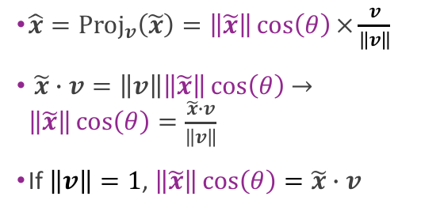
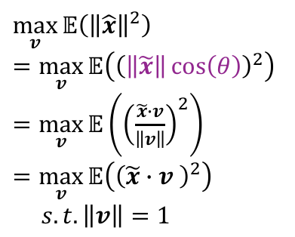
Geometric intuition
y
Demean, so that the origin is 0.
What is the key property of the new axis?
$$\tilde{x}$$
$$e$$
$$v$$
$\max_{v}{𝔼\left({\left\|\hat{x}\right\|}^{2}\right)}$
$=\max_{v}{𝔼\left({\left(\left\|\tilde{x}\right\|\cos\left(θ\right)\right)}^{2}\right)}$
$=\max_{v}{𝔼\left({\left(\frac{\tilde{x}∙v}{\left\|v\right\|}\right)}^{2}\right)}$
$=\max_{v}{𝔼\left({\left(\tilde{x}∙v \right)}^{2}\right)}$
$s.t.\left\|v\right\|=1$
$$θ$$
$$\hat{x}=αv$$
$\hat{x}={\text{Proj}}_{v}\left(\tilde{x}\right)=\left\|\tilde{x}\right\|\cos\left(θ\right)×\frac{v}{\left\|v\right\|}$
$\tilde{x}∙v=\left\|v\right\|\left\|\tilde{x}\right\|\cos\left(θ\right)$ $→\left\|\tilde{x}\right\|\cos\left(θ\right)=\frac{\tilde{x}∙v}{\left\|v\right\|}$
If $\left\|v\right\|=1$, $\left\|\tilde{x}\right\|\cos\left(θ\right)=\tilde{x}∙v$
x
o

Slide 19
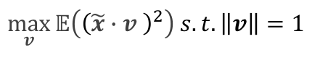
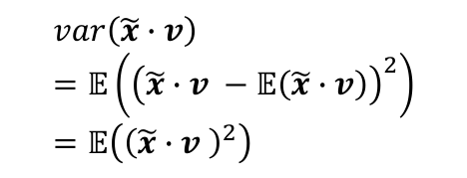
Geometric intuition
y
Demean, so that the origin is 0.
What is the key property of the new axis?
$$\tilde{x}$$
$$e$$
$$v$$
$\max_{v}{𝔼\left({\left(\tilde{x}∙v \right)}^{2}\right)}$ $s.t.\left\|v\right\|=1$
$$θ$$
$$\hat{x}=αv$$
x
o
$$var\left(\tilde{x}∙v\right)=𝔼\left({\left(\tilde{x}∙v −𝔼\left(\tilde{x}∙v\right)\right)}^{2}\right)=𝔼\left({\left(\tilde{x}∙v \right)}^{2}\right)$$
Minimizing approximation error
is equivalent to
maximizing directional variance (coordinate variance long a direction).

Slide 20
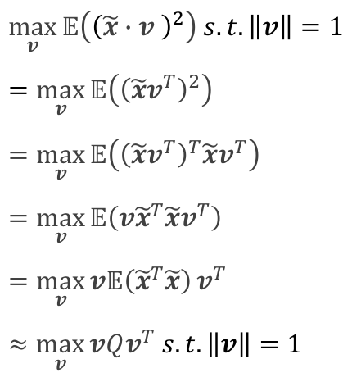
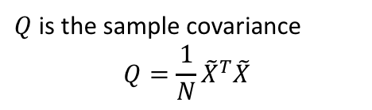
Geometric intuition
y
Demean, so that the origin is 0.
What is the key property of the new axis?
$$\tilde{x}$$
$$e$$
$$v$$
$\max_{v}{𝔼\left({\left(\tilde{x}∙v \right)}^{2}\right)}$ $s.t.\left\|v\right\|=1$
$=\max_{v}{𝔼\left({\left(\tilde{x}v^{T}\right)}^{2}\right)}$
$=\max_{v}{𝔼\left({\left(\tilde{x}v^{T}\right)}^{T}\tilde{x}v^{T}\right)}$
$=\max_{v}{𝔼\left(v{\tilde{x}}^{T}\tilde{x}v^{T}\right)}$
$=\max_{v}{v𝔼\left({\tilde{x}}^{T}\tilde{x}\right)}v^{T}$
$≈\max_{v}{vQv^{T}}$ $s.t.\left\|v\right\|=1$
$Q$ is the sample covariance
$$Q=\frac{1}{N}{\tilde{X}}^{T}\tilde{X}$$
$$θ$$
$$\hat{x}=αv$$
x
o
Directional variance can be calculated from the sample covariance.

Slide 21
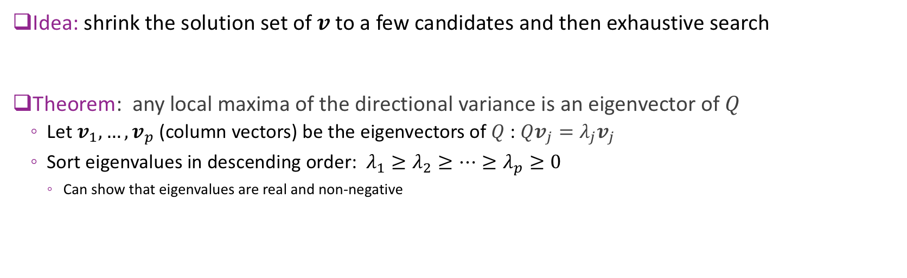

Optimization
$$max_{v}vQv^{T} s.t.\left\|v\right\|=1$$
Idea: shrink the solution set of $v$to a few candidates and then exhaustive search
Theorem: any local maxima of the directional variance is an eigenvector of $Q$
Let $v_{1},…,v_{p}$ (column vectors) be the eigenvectors of $Q$ : $Qv_{j}=λ_{j}v_{j}$
Sort eigenvalues in descending order: $λ_{1}≥λ_{2}≥…≥λ_{p}≥0$
Can show that eigenvalues are real and non-negative

Slide 22
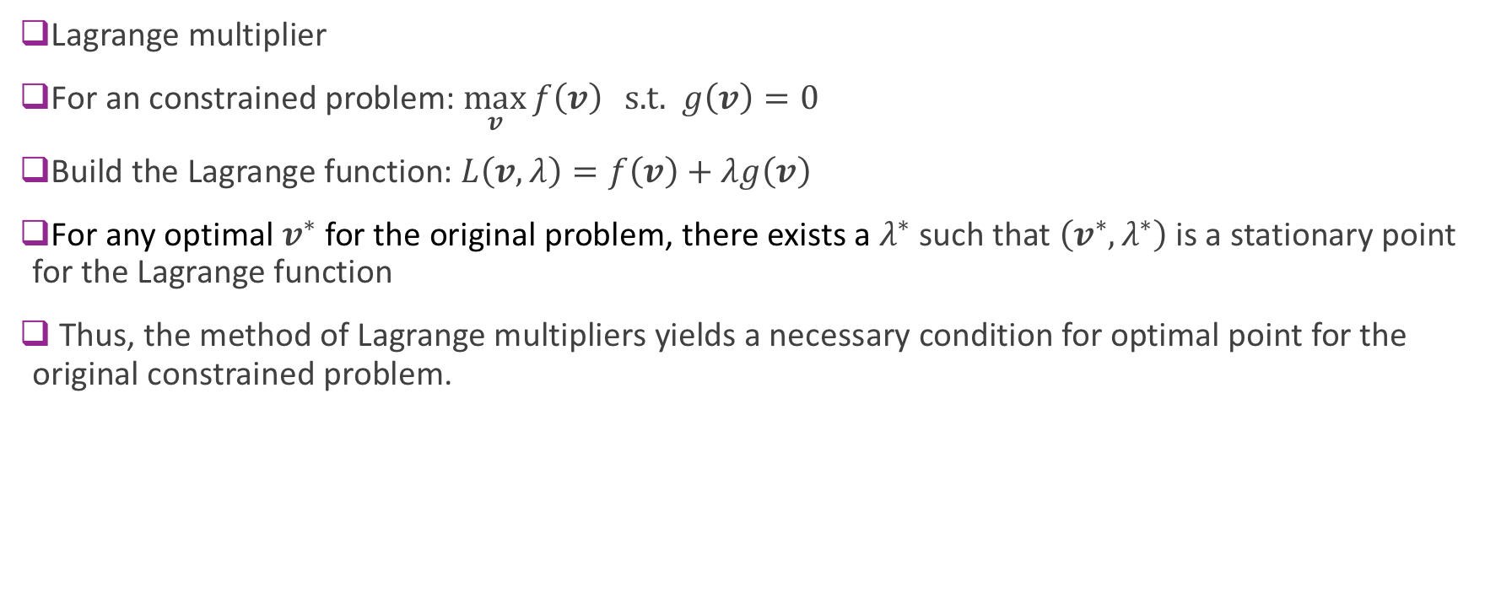
Optimization
Lagrange multiplier
For an constrained problem: $\max_{v}{f\left(v\right)} \text{s}\text{.}\text{t}\text{. } g\left(v\right)=0$
Build the Lagrange function: $L\left(v, λ\right)=f\left(v\right)+λg\left(v\right)$
For any optimal $v^{∗}$ for the original problem, there exists a $λ^{∗}$ such that $\left(v^{∗}, λ^{∗}\right)$ is a stationary point for the Lagrange function
Thus, the method of Lagrange multipliers yields a necessary condition for optimal point for the original constrained problem.

Slide 23
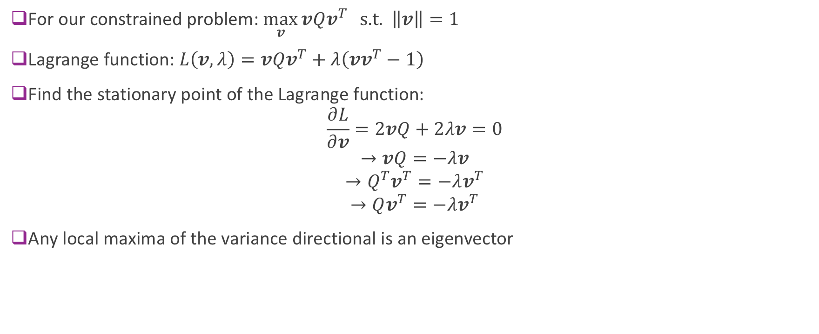
Optimization
For our constrained problem: $\max_{v}{vQv^{T}} \text{s}\text{.}\text{t}\text{. } \left\|v\right\|=1$
Lagrange function: $L\left(v, λ\right)=vQv^{T}+λ\left(vv^{T}−1\right)$
Find the stationary point of the Lagrange function:
$$\frac{∂L}{∂v}=2vQ+2λv=0$$
$$→vQ=−λv$$
$$→Q^{T}v^{T}=−λv^{T}$$
$$→Qv^{T}=−λv^{T}$$
Any local maxima of the variance directional is an eigenvector

Slide 24
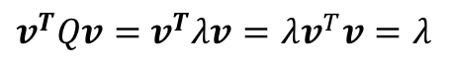
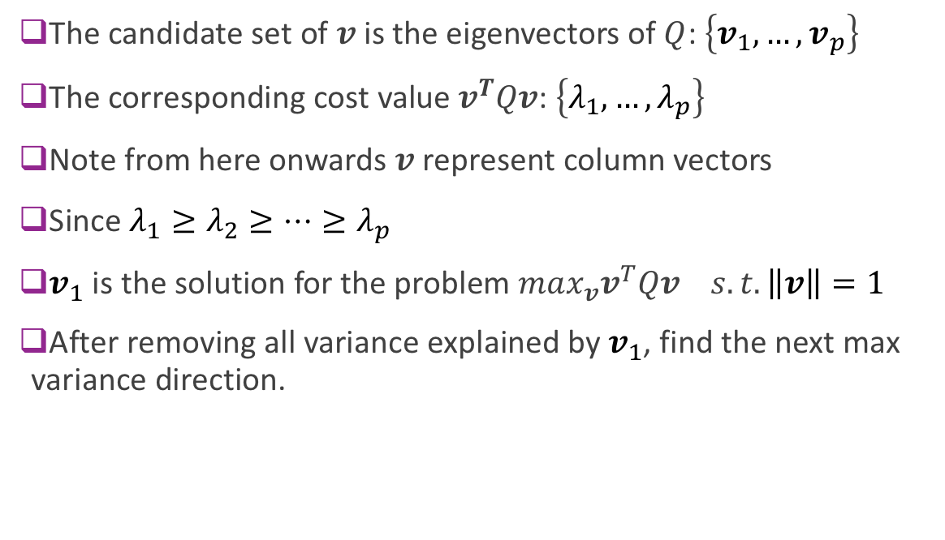
Optimization
The candidate set of $v$ is the eigenvectors of $Q$: $\left\{v_{1},…,v_{p}\right\}$
The corresponding cost value $v^{T}Qv$: $\left\{λ_{1}, …, λ_{p}\right\}$
Note from here onwards $v$ represent column vectors
Since $λ_{1}≥λ_{2}≥…≥λ_{p}$
$v_{1}$ is the solution for the problem $max_{v}v^{T}Qv s.t.\left\|v\right\|=1$
After removing all variance explained by $v_{1}$, find the next max variance direction.
$v^{T}Qv=$ $v^{T}λv=λv^{T}v=λ$
y
x’
o
x

Slide 25
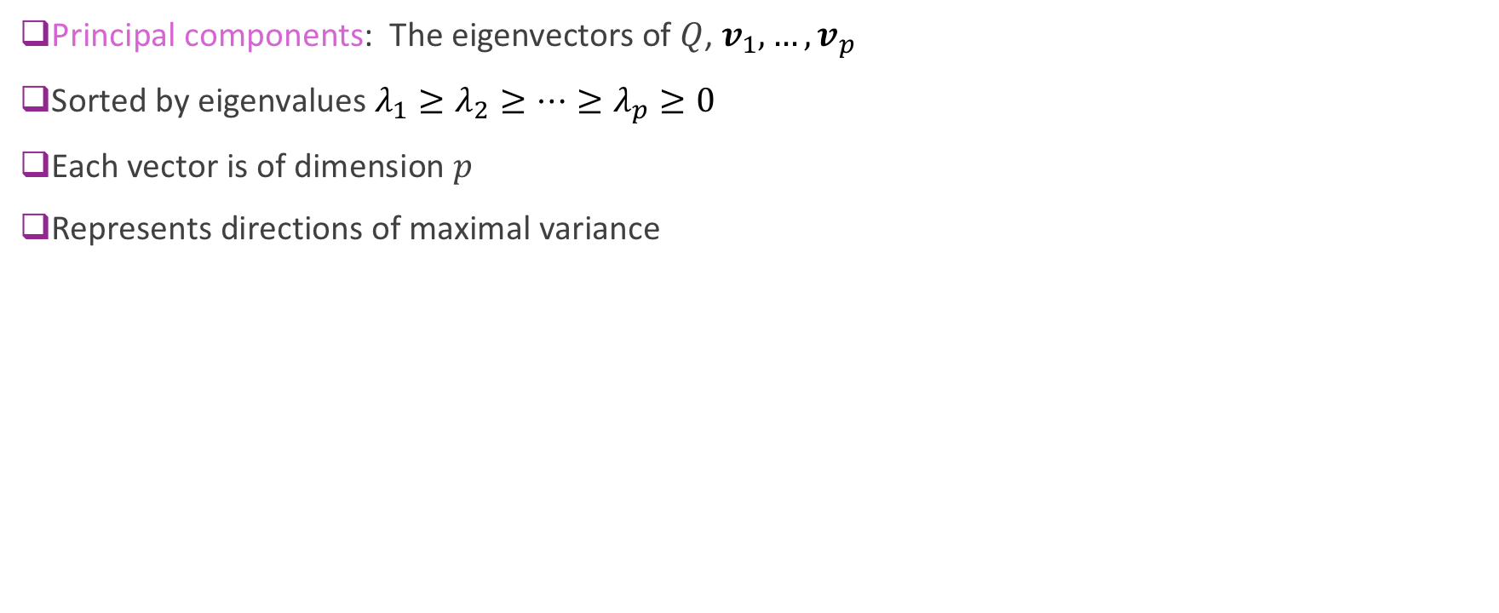
Principal Components
Principal components: The eigenvectors of $Q$, $v_{1},…,v_{p}$
Sorted by eigenvalues $λ_{1}≥λ_{2}≥…≥λ_{p}≥0$
Each vector is of dimension $p$
Represents directions of maximal variance

Slide 26
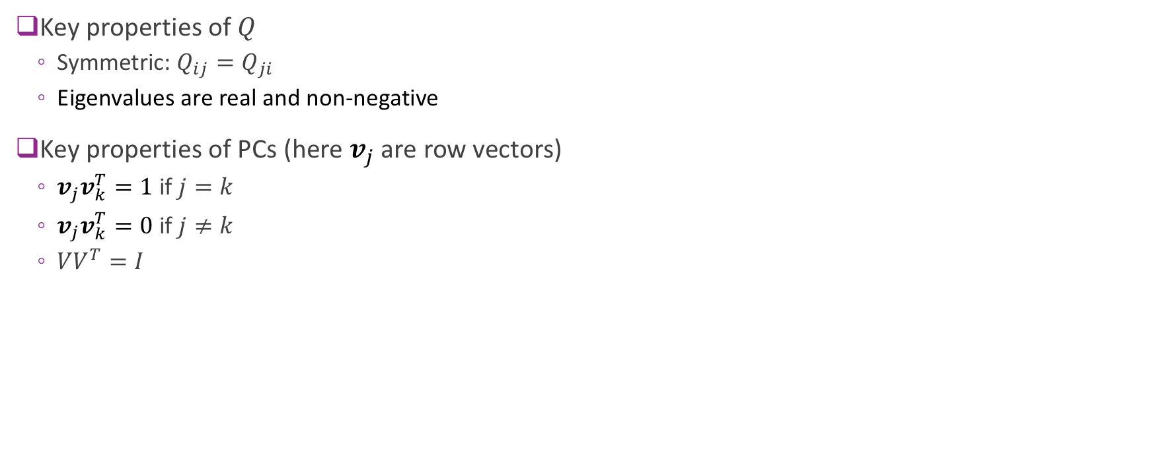
Principal Components
Key properties of $Q$
Symmetric: $Q_{ij}=Q_{ji}$
Eigenvalues are real and non-negative
Key properties of PCs (here $v_{j}$ are row vectors)
$v_{j}v_{k}^{T}=1 \text{if} j=k$
$v_{j}v_{k}^{T}=0$ if $j≠k$
${VV}^{T}=I$

Slide 27
Outline
Dimensionality reduction
Principal components and directions of variance (a geometric perspective)
Computing PCs via the SVD
Approximation with PCs
Face example in python
Extensions

Slide 28
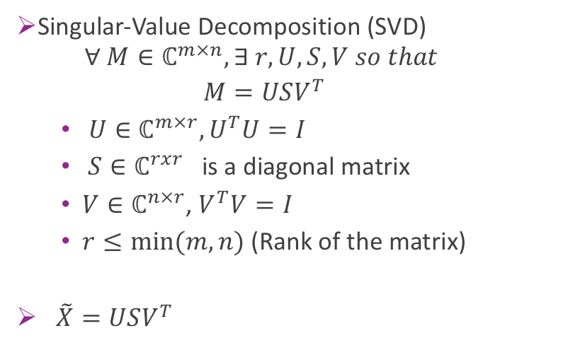
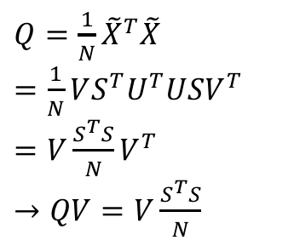
Computing PCs via the SVD
SVD provides a numerically more stable way to calculate PCs
$Q=\frac{1}{N}{\tilde{X}}^{T}\tilde{X}$
$=\frac{1}{N}VS^{T}U^{T}USV^{T}$
$=V\frac{S^{T}S}{N}V^{T}$
$→QV=V\frac{S^{T}S}{N}$
Singular-Value Decomposition (SVD)
$$∀ M∈ℂ^{m×n}, ∃ r, U, S, V so that$$
$$M=USV^{T}$$
$U∈ℂ^{m×r}, U^{T}U=I$
$S∈ℂ^{rxr}$ is a diagonal matrix
$V∈ℂ^{n×r}$, $V^{T}V=I$
$r≤min⁡(m,n)$ (Rank of the matrix)
$\tilde{X}=USV^{T}$

Slide 29


Computing PCs via the SVD
SVD provides a numerically more stable way to calculate PCs
$$QV=V\frac{S^{T}S}{N} or Qv_{i}=\frac{S_{ii}^{T}S_{ii}}{N}v_{i}$$
Rows of $V^{T}$ are eigenvectors of $Q$, e.g. PCs
$\frac{S^{T}S}{N}$ are the eigenvalues (real and nonnegative)
Singular-Value Decomposition (SVD)
$$∀ M∈ℂ^{m×n}, ∃ r, U, S, V so that$$
$$M=USV^{T}$$
$U∈ℂ^{m×r}, U^{T}U=I$
$S∈ℂ^{rxr}$ is a diagonal matrix
$V∈ℂ^{n×r}$, $V^{T}V=I$
$r≤min⁡(m,n)$ (Rank of the matrix)
$\tilde{X}=USV^{T}$

Slide 30
Outline
Dimensionality reduction
Principal components and directions of variance (a geometric perspective)
Computing PCs via the SVD
Approximation with PCs
Face example in python
Extensions

Slide 31




Average Approximation Error
Given data ${\tilde{x}}_{i}, i=1,…,N$
Let $v_{1},…,v_{p}$ be the PCs
Find coefficient expansion of each data sample: ${\tilde{x}}_{i}=\sum_{j=1}^{p}{α_{ij}v_{j}}, α_{ij}=v_{j}^{T}{\tilde{x}}_{i}$
Now consider approximation with $d$ coefficients: ${\hat{x}}_{i}=\sum_{j=1}^{d}{α_{ij}v_{j}}$
$$\tilde{X}$$
$$Α$$
$$Α$$
$$V$$
$$V^{T}$$
=
x

Slide 32

Average Approximation Error
Error in sample $i$: ${\tilde{x}}_{i}−{\hat{x}}_{i}=\sum_{j=d+1}^{p}{α_{ij}v_{j}}$
Theorem: Average error with a $d$ PC approximation is: $\frac{1}{N}\sum_{i=1}^{N}{{\left\|{\tilde{x}}_{i}−{\hat{x}}_{i}\right\|}^{2}}=\sum_{j=d+1}^{p}{λ_{j}}$
Sum of the smallest $p−d$ eigenvalues

Slide 33

Proportion of Variance (PoV)
Total variance of data set: $\frac{1}{N}\sum_{i=1}^{N}{{\left\|{\tilde{x}}_{i}\right\|}^{2}}=\sum_{j=1}^{p}{λ_{j}}$
Average approximation error: $\frac{1}{N}\sum_{i=1}^{N}{{\left\|{\tilde{x}}_{i}−{\hat{x}}_{i}\right\|}^{2}}=\sum_{j=d+1}^{p}{λ_{j}}$
The proportion of variance explained by $d$ PCs is: $PoV\left(d\right)=\frac{\sum_{j=1}^{d}{λ_{j}}}{\sum_{j=1}^{p}{λ_{j}}}$
Measure of approximation error in using $d$ PCs
Example: Suppose eigenvalues of sample covariance matrix are $10, 4, 0.2, 0.1, 0, 0, …$
What is the PoV for $d=1,2,3, …$

Slide 34

Visualizing the Representation
Finds a low-dimensional representation

Slide 35






Geometry of Approximations
Approximation can be interpreted geometrically
Let $V$ be set of all linear combinations $\sum_{j=1}^{d}{α_{j}v_{j}}$
$V$ is a vector space
Called the span of $v_{1},…,v_{d}$
Given $z$, $\hat{z}$ is the closest vector in $V$ to $z$
Called the projection of $z$ onto $V$
$$z$$
$$z−\hat{z}$$
$$\hat{z}$$
Space spanned by $v_{1},…,v_{d}$

Slide 36
Outline
Dimensionality reduction
Principal components and directions of variance (a geometric perspective)
Computing PCs via the SVD
Approximation with PCs
Face example in python
Extensions

Slide 37

Example: Faces
Face images can be high-dimensional
We will use 50 x 37 = 1850 pixels
But, there may be few degrees of freedom
Can we reduce the dimensionality of this?
Data Labelled Faces in the Wild project
http://vis-www.cs.umass.edu/lfw
Large collection of faces (13000 images)
Taken from web articles about 10 years ago

Slide 38


Loading the Data
Built-in routines to load data is sciket-learn
Can take several minutes the first time (Be patient)

Slide 39


Plotting the Data
Some example faces
You may be too young to remember them all

Slide 40


Computing the SVD
Note efficient use of python broadcasting
SVD:
Use full_matrices (avoids computing zero SVs)
Matrix V is what we call $V^{T}$ (Different from MATLAB)

Slide 41


Finding the PoV
Most variance explained in about 400 components
Some reduction

Slide 42

Plotting Approximations
Selection of figure sizes for subplot
Note: Efficient computing of approx

Slide 43

Plotting the Approximations

Slide 44

Plotting the PCs
The PCs can be plotted as well
These are known as Eigenfaces!

Slide 45
How do we use Principle Components?
PCs tell us “latent” factors of the data
Each sample is a weighted average of these PCs (eg. eigen-faces)
Can use the coefficients as low-dimension features for classification
Early success with face recognition (using projection onto eigenfaces)
Can use the coefficients for compression
JPEG image coder: uses DCT basis at block level
JPEG wavelet coder: uses Wavelet basis over entire image
Denoising
Project noisy data onto the basis vectors
Reconstruct from low freq. basis vectors
Data normalization: scaled coefficients will be independent and have unit variance.

Slide 46
Other Considerations
Normalization: For most data, it is essential to standardize before computing PC
Otherwise, components with large values dominate small ones
Sklearn has built in PCA routine (will explore in lab)
Some texts do not subtract mean
Will be picked up as one of the PCs

Slide 47
Outline
Dimensionality reduction
Principal components and directions of variance (a geometric perspective)
Computing PCs via the SVD
Approximation with PCs
Face example in python
Extensions

Slide 48


Orthonormal Sets and Bases
Definition: A set of vectors $v_{1},…,v_{d}$ are an orthonormal set if:
$\left\|v_{j}\right\|=1$ for all $j$ (unit length)
$v_{j}^{T}v_{k}=0$ if $j≠k$ (perpendicular to one another)
If $d=p$ then $v_{1},…,v_{p}$ is called an orthonormal basis
Matrix form: If $V=\left[v_{1} …v_{d}\right],$ then $V^{T}V=I_{d}$
If $d=p$, then $V$ is an orthogonal matrix

Slide 49

Coefficients in an Orthonormal Basis
For an orthonormal set $V$ $α=V^{T}x, x=Vα$
Examples of Orthonormal Basis:
PCs, a data driven orthonormal basis
Discrete Fourier Transform (normalized)
Discrete Cosine Transform
Wavelet transform

Slide 50





Wiberg’s Method
PCA with missing data
$$\underset{V}{argmin}{\min_{A}{{\left\|\tilde{X}−AV\right\|}_{F}}}$$
$$\tilde{X}$$
$s.t.{VV}^{T}=I$
$\tilde{X}∈ℝ^{N×p},A∈ℝ^{N×d},V∈ℝ^{d×p}, d≤p$
NA
NA
$$\underset{V}{argmin}{\min_{A}{{\left\|W∘\left(\tilde{X}−AV\right)\right\|}_{F}}}$$
NA
$s.t.{VV}^{T}=I$
$\tilde{X}∈ℝ^{N×p},A∈ℝ^{N×d},V∈ℝ^{d×p}, d≤p$
$W_{ij}=1 if valid data, otherwise 0$
NA

Slide 51




Robust PCA
PCA is known sensitive to outlier
$$\underset{V}{argmin}{\min_{A}{{\left\|\tilde{X}−AV\right\|}_{F}}}$$
$s.t.{VV}^{T}=I$
$\tilde{X}∈ℝ^{N×p},A∈ℝ^{N×d},V∈ℝ^{d×p}, d≤p$
y
x
$\underset{V}{argmin}{\min_{A}{{\left\|L−AV\right\|}_{F}}+λ}$ ${\left\|S\right\|}_{1}$
o
$s.t.\tilde{X}=L+S$
${VV}^{T}=I$
$\tilde{X}∈ℝ^{N×p},A∈ℝ^{N×d},V∈ℝ^{d×p}, d≤p$

Slide 52













Sparse orthonormal transforms
From low rank to sparsity
$$\tilde{X}$$
$$Α$$
$$\underset{V}{argmin}{\min_{A}{{\left\|\tilde{X}−AV\right\|}_{F}}}$$
$$Α$$
$$V$$
=
$$V$$
X
$s.t.{VV}^{T}=I$
$\tilde{X}∈ℝ^{N×p},A∈ℝ^{N×d},V∈ℝ^{d×p}, d≤p$
$\underset{V}{argmin}{\min_{A}{{\left\|\tilde{X}−AV\right\|}_{F}}+λ}$ ${\left\|A\right\|}_{1}$
$$\tilde{X}$$
$$Α$$
=
$$Α$$
$$V$$
X
$s.t.{VV}^{T}=I$
$\tilde{X}∈ℝ^{N×p},A∈ℝ^{N×p},V∈ℝ^{p×p}$

Slide 53







KSVD
More parsimonious representation with redundant dictionary
$$\tilde{X}$$
$$Α$$
$$Α$$
$$\underset{V}{argmin}{\min_{A}{{\left\|\tilde{X}−AV\right\|}_{F}}}$$
$$V$$
=
$$V$$
X
$s.t.{VV}^{T}=I$
$\tilde{X}∈ℝ^{N×p},A∈ℝ^{N×d},V∈ℝ^{d×p}, d≤p$
$$\tilde{X}$$
$$Α$$
$$\underset{V}{argmin}{\min_{A}{{\left\|\tilde{X}−AV\right\|}_{F}}}$$
$$V$$
=
$$Α$$
X
$$s.t. \tilde{X}∈ℝ^{N×p},A∈ℝ^{N×d},V∈ℝ^{d×p}, \left(d≥p\right)$$

Slide 54

Linear discriminative analysis
Projects to the most discriminative direction
Supervised learning with labels
Simultaneously maximizing between classes variance and minimizing within class variance
*figure from Bishop, Pattern Recognition and Machine Learning

Slide 55


Linear discriminative analysis
Projects to the most discriminative direction
Supervised learning with labels
Simultaneously maximizing between classes variance and minimizing within class variance
*figure from http://scikit-learn.org

Slide 56



Linear discriminative analysis
Projects to the most discriminative direction
Supervised learning with labels
Simultaneously maximizing between classes variance and minimizing within class variance
*figure from http://scikit-learn.org

Slide 57





State-of-the-Art: Auto-Encoders
PCA is a simple example of an autoencoder
Tries to find low-dim representation
Restricted to linear transforms
Not very good for images and complex data
$$α=V^{T}x$$
$$\hat{x}=Vα$$
$$x$$
High-dim object
$$α$$ Low-dim representation
$$\hat{x}$$
Approximation

Slide 58

Deep Auto-Encoders
Can use deep networks for learning complex latent representations and their inverses
http://www.cc.gatech.edu/~hays/7476/projects/Avery_Wenchen/
https://swarbrickjones.wordpress.com/2016/01/13/enhancing-images-using-deep-convolutional-generative-adversarial-networks-dcgans/ (Code in Theano not tensorflow)
Autoencoder for image completion

Slide 59

Representation with deep learning
MNIST in 3D
*figure from https:// tensorflow.org

